Slide 1
Paintings and Language
Ben Barrett, Austin Cheng, Daniel Choi
Notes:
In this project we generate new image-text examples - painting images with titles - using GANs

Slide 2
Introduction
Image Generation
Generative Adversarial Network (GAN)
Text Generation
Recurrent Neural Network (RNN)
Long short-term Memory (LSTM)
Image-Text Generation
Transformers (e.i. UNITER)
Multimodal GAN
Notes:
GANs have seen growing popularity and for our class on Vision and Language we wanted to explore whether we could extend traditional purely image GANs for image-text generation. We chose paintings because their more abstract titles seemed more suitable for the sort of “creativity” of generative models. We tried two approaches, a sequential model, where first a purely image GAN produces an image, and then we caption the image using a LSTM; and a parallel model, which is a multimodal GAN where the generator produces an image and text pair, and the discriminator takes in both image and text for classifying as real or fake.

Slide 3
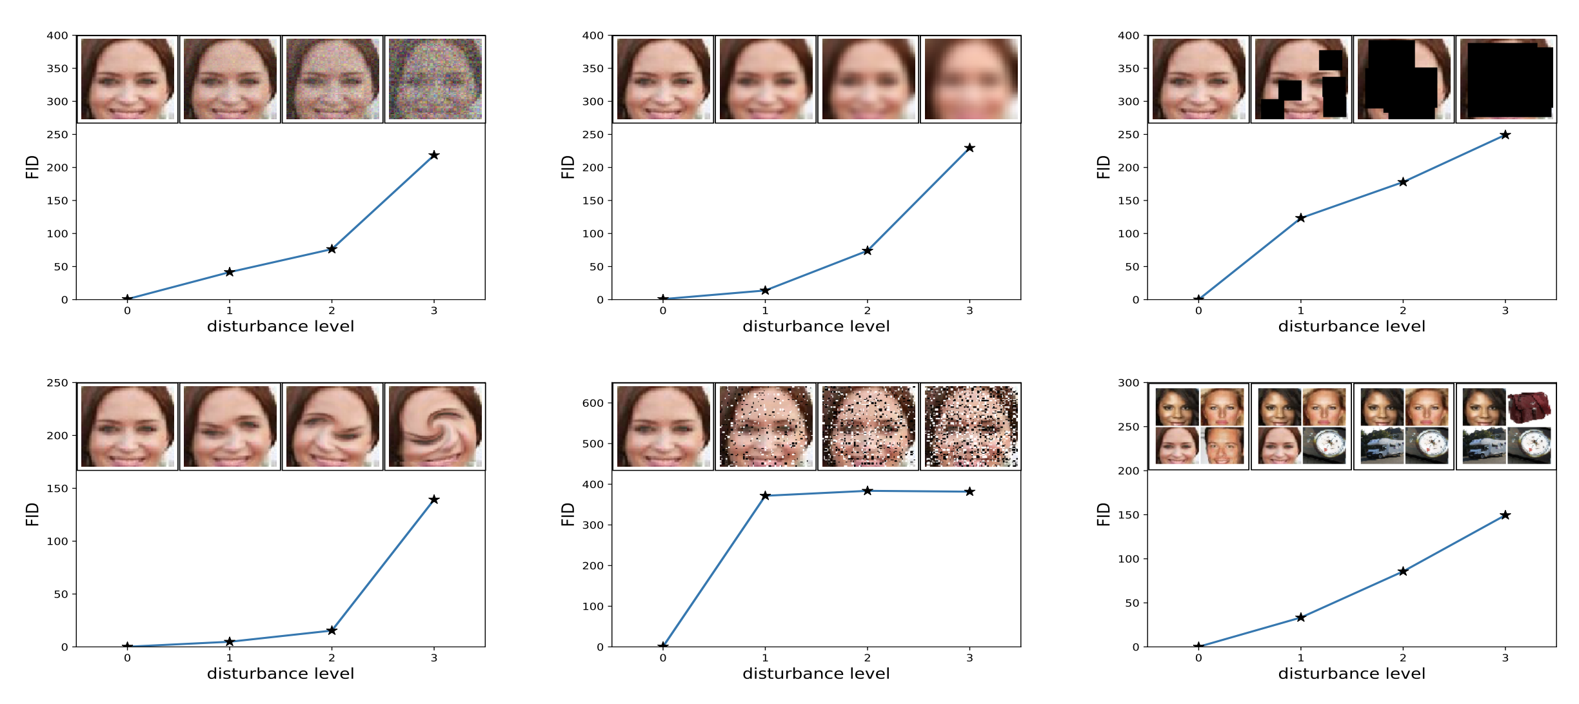
Related Works
Fréchet Inception Distance (FID)
Proposed by Martin Heusel, et al. (2017)
Used to measure the performance of GAN
Notes:
Measures the difference in Distribution of the image data. Given that we are comparing datasets, it is expected we won’t be getting a FID value of 0. But rather higher value.

Slide 4
Data
The Metropolitan Museum of Art (MET)
6664 images
2788 Oil Paintings
Kaggle (Wikiart)
79433 images of various styles
Notes:
We used two datasets: For the Met dataset, we webscraped from the Met’s Open Access Initiative all open access works that were labeled as paintings and obtained 6664 paintings. Of these, 2788 were oil paintings, which we separated out because it seemed to provide a dataset of higher quality. Downloaded images were very high quality and to save space each image was resized so that its longest side was 1024 pixels. We also use a publicly provided Kaggle dataset that was collected from WikiArt which has many more examples.

Slide 5
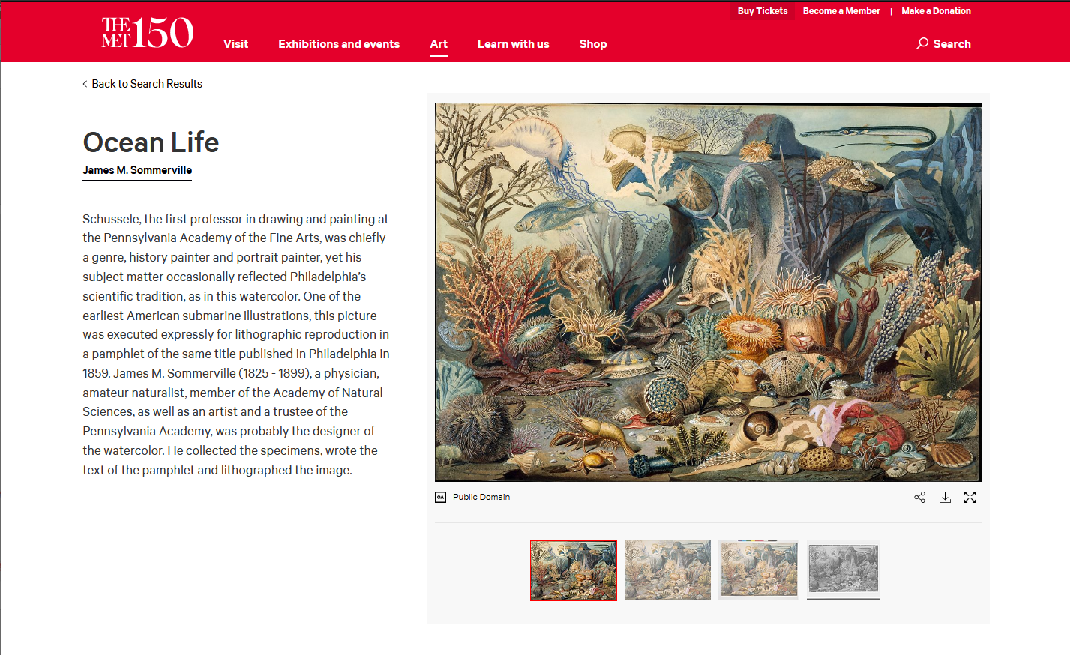

Slide 6
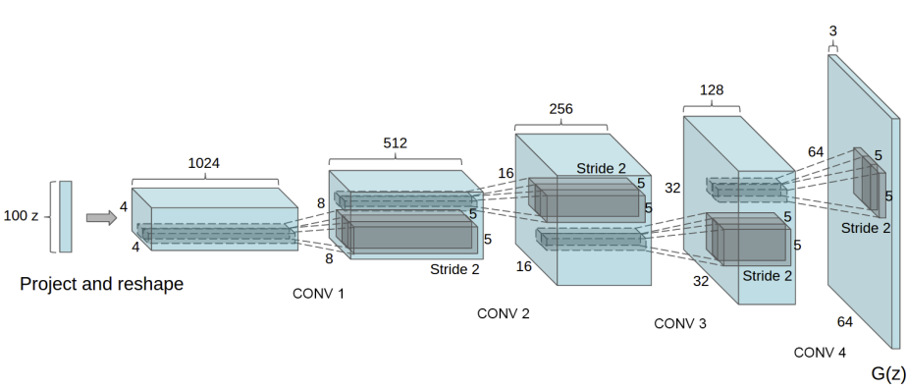
Models
Image Generation
Deep Convolutional GAN (DCGAN)
Ngf = 128
Ndf = 32
lr = 0.0002
Notes:
What are NGF, NDF. (64,64) for smaller version, but change in value to balance for higher resolution

Slide 7
Models
Text Generation
Tokenizer
Bag of Words
Vocab size (20,000/5,000)
Encoder
Resnet
Dropout Layers n = 0.3
Decoder
LSTM based RNN
encoding size = 512
Notes:
Used a bag of words tokenizer in an encoder decoder framework. The encoder used ResNet under the hood with dropout layers to prevent overfitting. The decoder was an LSTM based RNN.

Slide 8
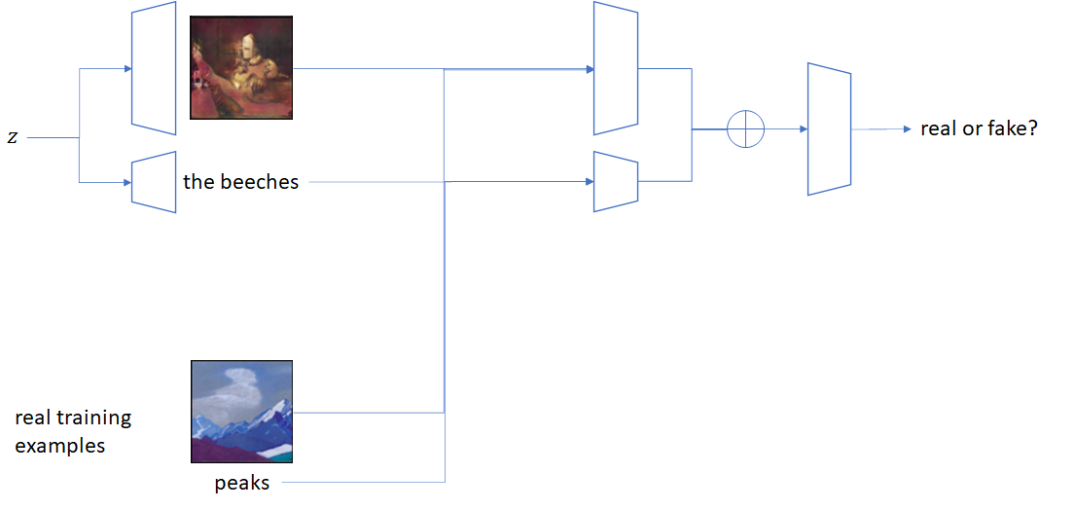
Models
Image-Text Generation
Notes:
An attempt was made to define and train a multimodal GAN with a generator that produces image-text pairs and a discriminator that encodes and classifies image-text pairs. The generator contained an image decoder and a text decoder that both decoded from the same latent z vector, while the discriminator contained an image encoder and a text encoder, and the outputs of these encoders were concatenated and then a final linear layer was applied. However, it seems that this architecture was ill-defined, as even after 40 epochs, generated outputs resembled noise.

Slide 9
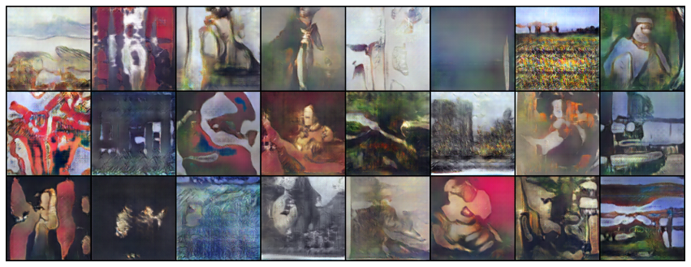
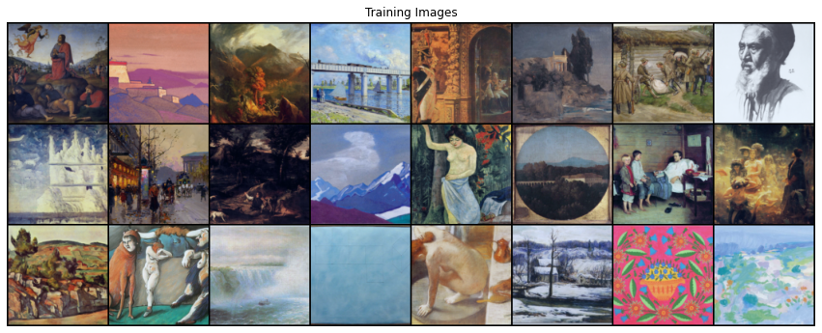
Experiment and
Results
Image Generation (Kaggle)
Notes:
40 epochs noticable how it creates human figures and also scenery on the first row. As more epochs, the blending of colors got more natural. More blocky in initial stages

Slide 10
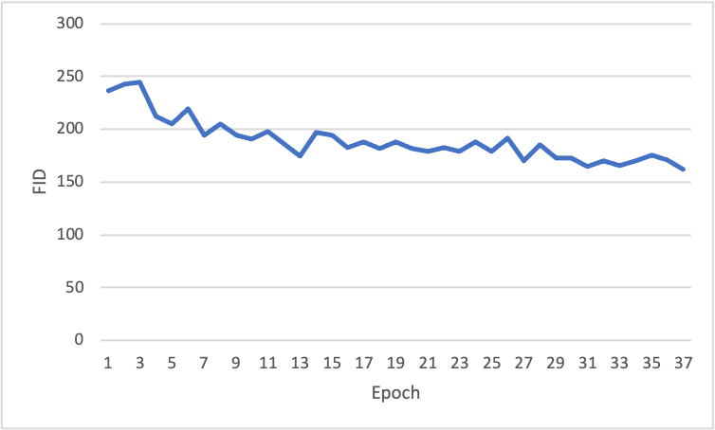
Experiment and
Results
Image Generation (Kaggle)
FID Score
Notes:
FID Score for Kaggle. 164 at minimum. 123 with images within the actual training images, indicating great performance

Slide 11
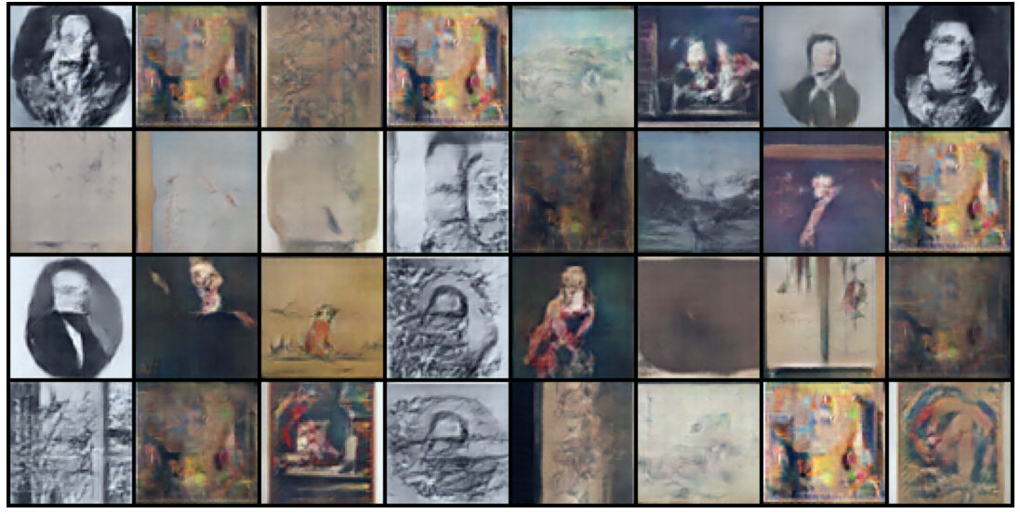
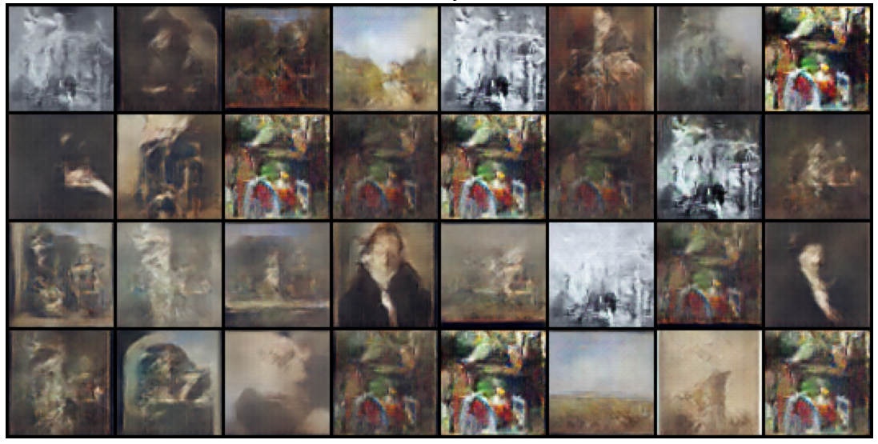
Experiment and
Results
Image Generation (MET)
Notes:
Images generated with MET Dataset. Also worked well for 64 GAN, but 128GAN was unable to produce any images with meaningful features.
Oil is able to produce images with seemingly more texture, but due to lack of images, we can see repeated images.

Slide 12
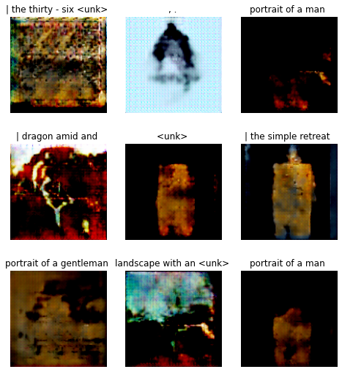
Experiment and
Results
Captioning (MET)
Notes:
Captioning results were completed on the higher resolution GAN outputs. Here are the captioning results for the MET dataset. The model is able to generate captions with simple structures

Slide 13
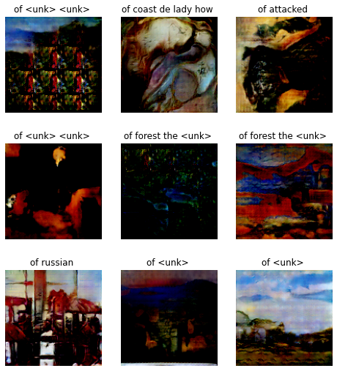
Experiment and
Results
Captioning (Kaggle)
Notes:
These are some results on the Kaggle dataset. The model was generally more unsure of itself with this dataset, categorizing more things as unknown, but does generate captions that almost make sense.

Slide 14
Conclusion and
Future Works
Conclusion
Sequential Model worked better
Future Works
Working with a different type of GAN
Experimenting with different structure
Use of Transformers
Notes:
DCGAN worked nicely, but it isnt known for its performance in higher resolution. DIfferent models such as MSG-GAN could be experimented.
In the future, we hope to explore.
State of the art in StyleGAN-2 could have been useful
Different model for generating text?
Using Transformers such as UNITER?
Thank you very much.

